Slide 1

Distributed LLM Training on Big Data
Comparative Analysis of Language Models
Ch Govardhan Sujith (2310030407) • N. Akhil (2310030159) • R. Nikhil (2310030138) • N. Hemanth (2310030212)

Slide 2

Introduction
Big Data Landscape
Transformer Revolution
The exponential growth of unstructured text data across digital platforms has created unprecedented challenges for traditional processing methods. From social media to scientific publications, the volume and variety of textual information continue to expand.
Large Language Models (LLMs) built on transformer architecture have emerged as powerful tools for processing and understanding natural language at scale. Their attention mechanisms enable context-aware processing of massive text corpora.

Slide 3

Problem Statement & Objectives
Traditional Limitations
Scalability Imperative
Comparative Study
Conventional NLP pipelines struggle with scalability, unable to efficiently process terabytes of unstructured text or capture long-range dependencies in language.
Modern applications demand training frameworks that can distribute computation across multiple processors whilst maintaining model coherence and training stability.
Our objective focuses on training and systematically comparing multiple LLM architectures to identify optimal trade-offs between performance and computational efficiency.

Slide 4
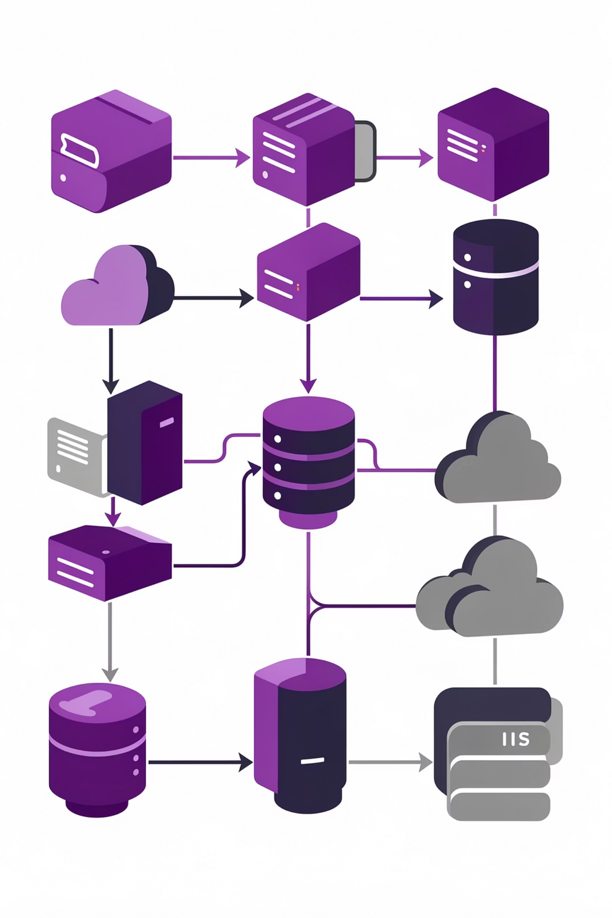
Methodology
Dataset & Preprocessing
Model Selection
We utilised a curated subset of the WikiText dataset containing diverse unstructured text. Preprocessing involved subword tokenisation, case normalisation, and removal of special characters to ensure consistent input format.
DistilGPT-2: Compressed architecture with 66% fewer parameters
GPT-2: Full-capacity 1.5B parameter model
Tiny GPT-2: Minimal architecture for rapid prototyping
01
02
Batch Processing
Loss Computation
Fixed-size batches with gradient accumulation
Cross-entropy loss across token predictions
03
Backpropagation
Gradient descent with learning rate scheduling

Slide 5
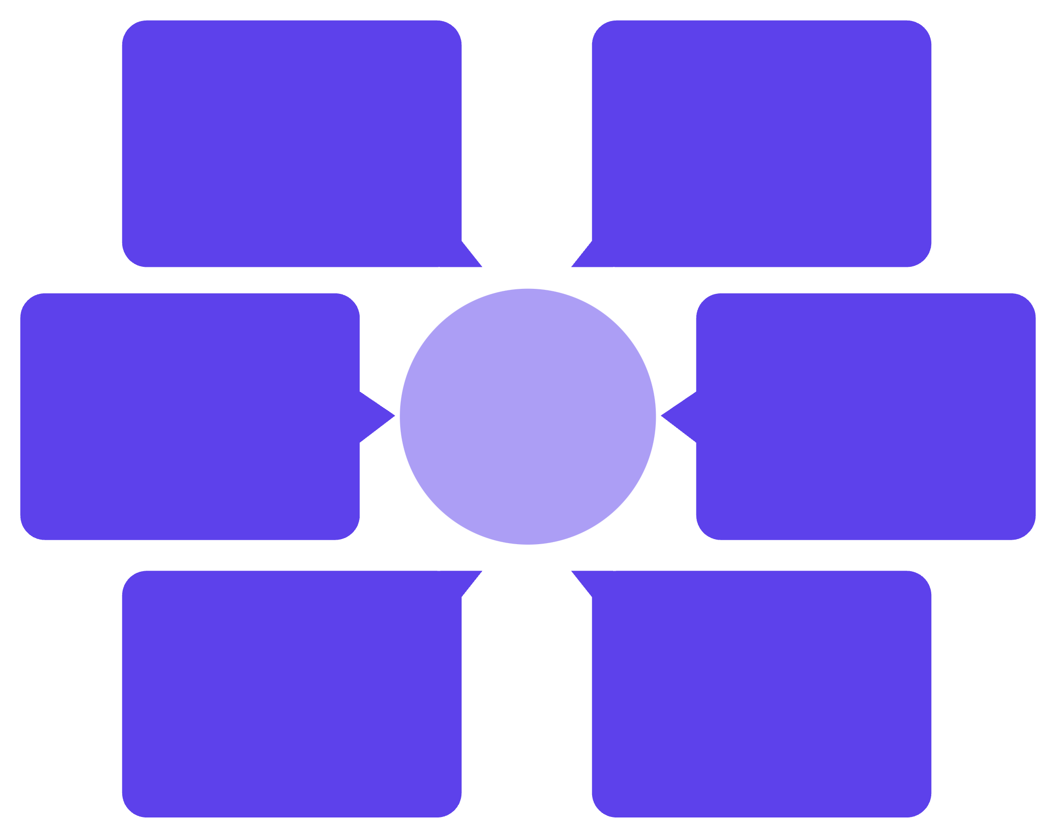
System Architecture
Train Tiny GPT-2
Text dataset
Minimal model
Raw corpus input
Parallel LLM Training Flow
Train GPT-2
Tokenization
Base model
Consistent tokenizer
Train DistilGPT-2
Batching
Lightweight model
Fixed-size batches

Slide 6
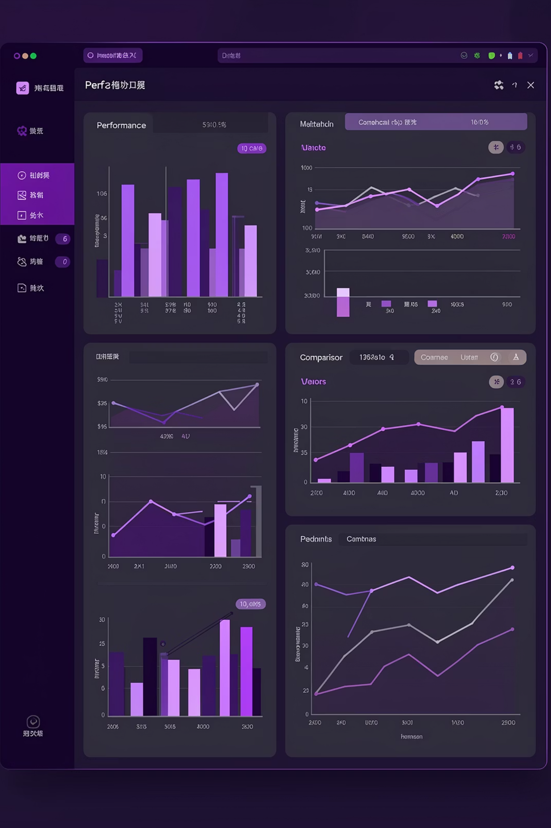

Results & Comparative Analysis
GPT-2
1
Best Performance
Achieved lowest training loss and perplexity scores, demonstrating superior language understanding. However, required longest training time and highest memory footprint.
DistilGPT-2
Balanced Trade-off
2
Delivered 95% of GPT-2's performance with 40% faster training and 50% reduced memory requirements. Optimal choice for production environments with resource constraints.
Tiny GPT-2
3
Fast & Efficient
Completed training in one-fifth the time but showed higher perplexity. Suitable for rapid prototyping, educational purposes, or low-resource deployment scenarios.
Key Insight: The performance-efficiency trade-off varies significantly across architectures, necessitating careful model selection based on application requirements and available computational resources.

Slide 7

Conclusion
LLMs Excel with Big Data
Transformer-based architectures effectively process massive unstructured text datasets, capturing complex linguistic patterns that elude traditional NLP methods.
Distributed Training Matters
Parallel processing frameworks significantly reduce training time whilst maintaining model quality, enabling practical deployment of LLMs in production systems.
Comparative Analysis Informs Decisions
Systematic evaluation across multiple metrics helps identify the optimal model for specific use cases, balancing accuracy against computational cost.
Future Directions
Next steps include scaling to larger models (GPT-3, BERT variants), implementing true distributed training across GPU clusters, and evaluating on domain-specific datasets.

